Slide 1
*
THE EMOJOURNAL
("Because your emotions deserve to be heard.")
Name: VISHAL TOGSIA
Problem statement: Create an emotional journal that classifies and visualizes mood trends.

Slide 2
BRIEF ABOUT THE IDEA
• Emojournal is a chat-based emotional journaling app for improving mental well-being
• Users talk to a friendly GPT-powered bot that asks how their day was in a calm and caring way
• The bot uses emotion detection AI to understand the user's mood from each message
• Emotions like Happy, Sad, Angry, Anxious, or Neutral are automatically classified
• Each mood is saved with a date, and shown in a calendar or bar chart
• Based on the mood, the app suggests motivational quotes, calming tips, or music
• The interface is clean, minimal, and supports dark/light mode for better experience
• The goal is to make mental health tracking easy, private, and emotionally supportive

Slide 3
How different is it from any of the other existing ideas?
Instead of typing on your own, you chat with a friendly AI bot that guides you like a real conversation.
It checks your emotion in every single message, not just the full journal — this gives more accurate mood tracking.
Based on your mood, it shows quotes, tips, or music to help you feel better — not just shows a chart.
It can understand emotions like anger, stress, or anxiety — not just "happy" or "sad".
The app is clean and easy to use, with a simple design and light/dark mode.
You can see your mood history in a calendar or graph, making it easy to understand how your emotions change over time.
Along with journaling, users can also book a one-on-one call with a real therapist for deeper mental health support and guidance.

Slide 4
How will it be able to solve the problem?
• Helps users understand their emotions by tracking how they feel each day through conversation, not just plain writing.
• Shows clear mood trends with graphs and calendars, making it easy to spot emotional patterns over time.
• Gives instant emotional support through quotes, tips, and music based on the user's mood — not just storing feelings.
• Encourages daily self-reflection by using a chatbot that asks thoughtful questions in a safe, non-judgmental way.
• Offers real therapist support through one-on-one calls for users who need professional mental health help.
• Reduces emotional stress by allowing users to express freely in a private, guided space without needing to explain themselves to others.
• Builds a healthy journaling habit that improves self-awareness, emotional control, and overall mental wellness.

Slide 5

USP of the proposed solution
1. Freemium Model
The basic version (journaling + mood tracking) is free. Extra features like mood reports, recommendations, and a clean user experience.
2. Subscription Plans
Users can pay monthly or yearly to get features like weekly mood summaries, guided journaling, and real therapist consultations.
3. Therapist & Clinic Partnerships
Work with psychologists or clinics by sharing user mood trends (with permission) to improve real mental health care.
4. Corporate Wellness Programs
Sell the app to companies as a mental wellness tool for employees — a growing demand in the corporate world.
5. Affiliate Content Suggestions
Recommend books, music, or meditation apps based on user mood — and earn through partnerships.

Slide 6
Technologies to be used in the solution
Frontend:
Built using React.js for fast, smooth user experience and responsive design.
Backend:
Developed using Node.js + Express to manage chat flow, user data, and API connections.
AI Chatbot:
Powered by OpenAI GPT model to carry natural and reflective conversations with the user.
Emotion Detection:
Uses transformer-based emotion classification model (like j-hartmann/emotion-english-distilroberta-base) for accurate emotion tagging. Data Visualization:
Chart.js or D3.js to display mood trends in graphs or calendars.
Database:
MongoDB to store user chats, emotion logs, and preferences securely.
Authentication & Privacy:
Uses JWT tokens and end-to-end encryption to ensure data privacy and secure login

Slide 7
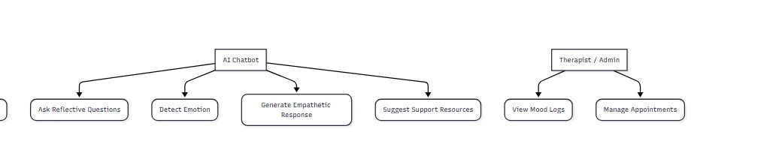
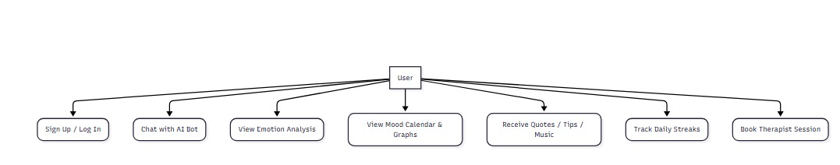
Process flow diagram or use-case diagram

Slide 8
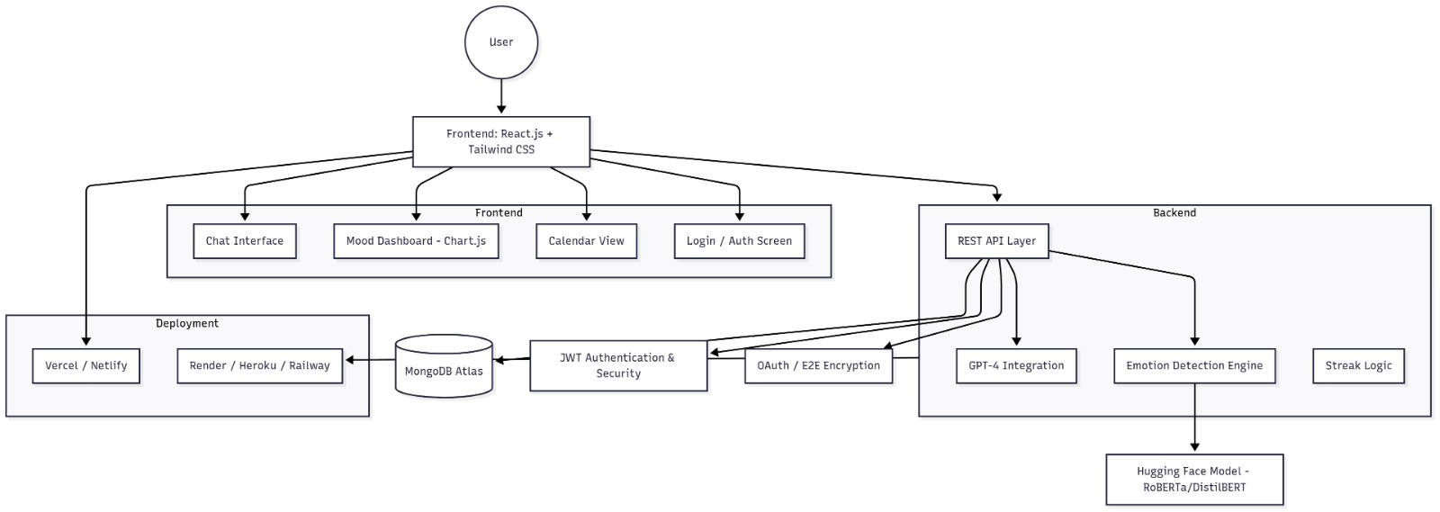
Architecture diagram of the proposed solution

Slide 9
Thank You

